Slide 1

MexE 406
Robotics 1
Engr. Mikko A. De Torres
Mechatronics Engineer
Department of Electronics Engineering
Batangas State University || College of Engineering

Slide 2
“Types: Number of Degrees of Freedom”
Engr. Mikko A. De Torres
Mechatronics Engineer
Department of Electronics Engineering
Batangas State University || College of Engineering

Slide 3

Degrees of Freedom (DOF)
Defined as the minimum number of independent parameters/ variables/ coordinates needed to describe a system completely.

Slide 4
Note: The following are ideal DOF
A point in 2D: 2-DOF; in 3D space: 3-DOF
A rigid body in 3D: 6-DOF
Planar Manipulator: 3-DOF
Spatial Manipulator: 6-DOF

Slide 5
Types based on the number of Degrees of Freedom
Under-actuated Manipulator
Either a Spatial Manipulator w/ less than 6-DOF or a Planar Manipulator w/ less than 3-DOF.
Ideal Manipulator
Either a Spatial Manipulator w/ exactly 6-DOF or a Planar Manipulator w/ exactly 3-DOF.
Redundant Manipulator
Either a Spatial Manipulator w/ more than 6-DOF or a Planar Manipulator w/ more than 3-DOF.

Slide 6
Importance of Under-actuated, Ideal and Redundant

Slide 7
DOF vs Mobility
Note: If the DOF of a manipulator is more than the ideal or based on your calculation it is a Redundant Manipulator it will be called Mobility.

Slide 8
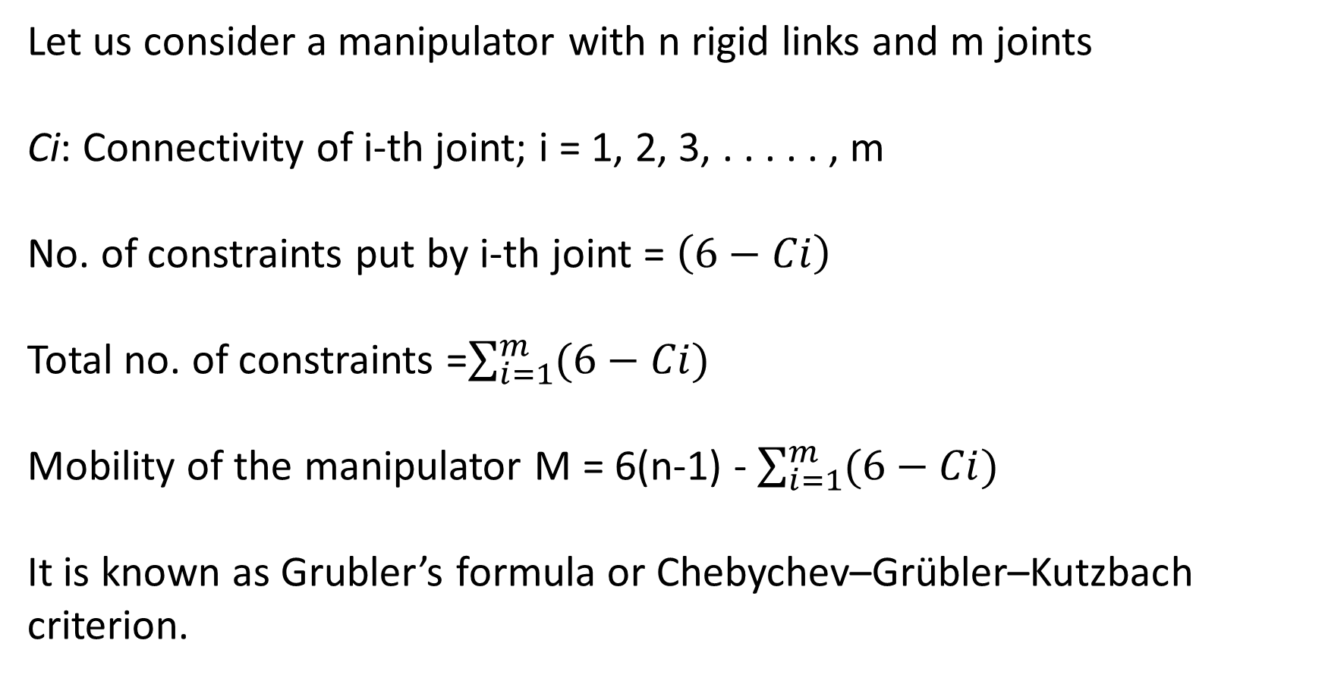
Grubler’s Criterion for Mobility/DOF of Spatial Manipulator
Let us consider a manipulator with n rigid links and m joints
Ci: Connectivity of i-th joint; i = 1, 2, 3, . . . . . , m
No. of constraints put by i-th joint = $\left(6−Ci\right)$
Total no. of constraints =$\sum_{i=1}^{m}{(6−Ci)}$
Mobility of the manipulator M = 6(n-1) - $\sum_{i=1}^{m}{(6−Ci)}$
It is known as Grubler’s formula or Chebychev–Grübler–Kutzbach criterion.

Slide 9
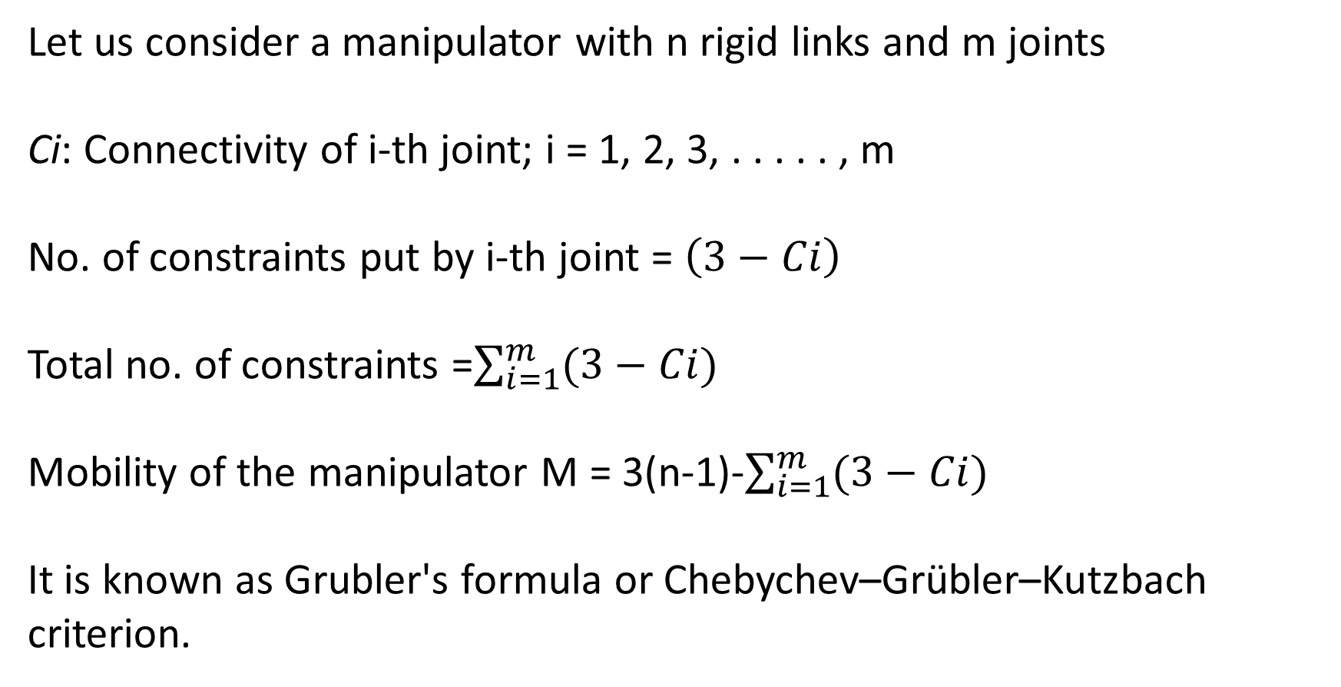
Grubler’s Criterion for Mobility/DOF of Planar Manipulator
Let us consider a manipulator with n rigid links and m joints
Ci: Connectivity of i-th joint; i = 1, 2, 3, . . . . . , m
No. of constraints put by i-th joint = $\left(3−Ci\right)$
Total no. of constraints =$\sum_{i=1}^{m}{(3−Ci)}$
Mobility of the manipulator M = 3(n-1)-$\sum_{i=1}^{m}{(3−Ci)}$
It is known as Grubler's formula or Chebychev–Grübler–Kutzbach criterion.

Slide 10
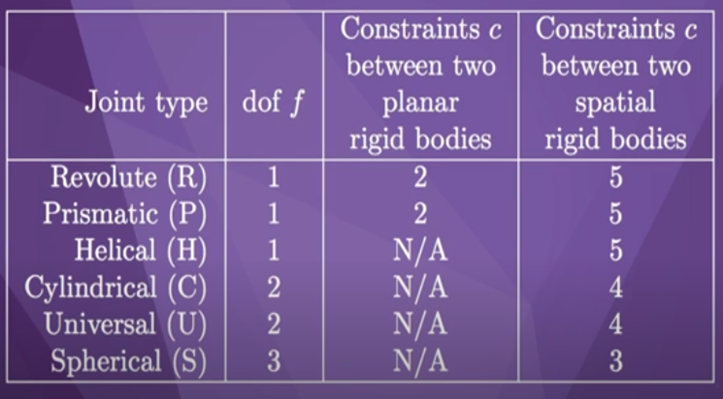

Slide 11
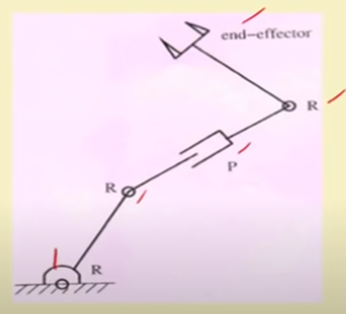
Example 1: Planar Manipulator

Slide 12
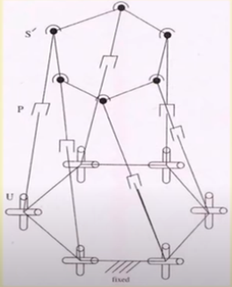
Example 2: Parallel Manipulator

Slide 13
Example 3: RRR Spatial Manipulator

Slide 14
Example 4: RRP SCARA Spatial Manipulator

Slide 15
Self Review

Slide 16
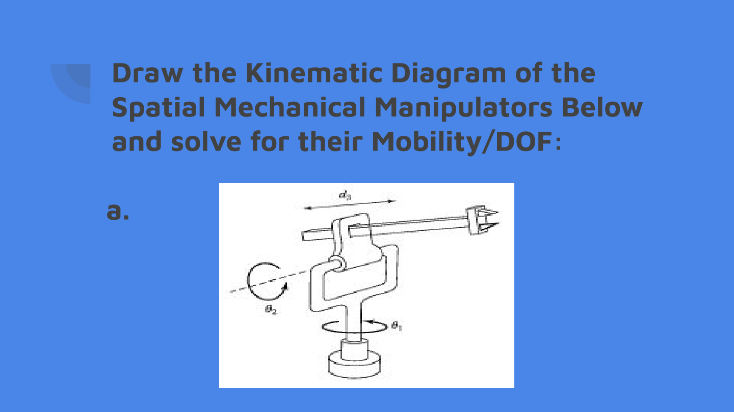
Example 1: RRP Spherical Manipulator

Slide 17
Test 2: PPP Cartesian Manipulator

Slide 18
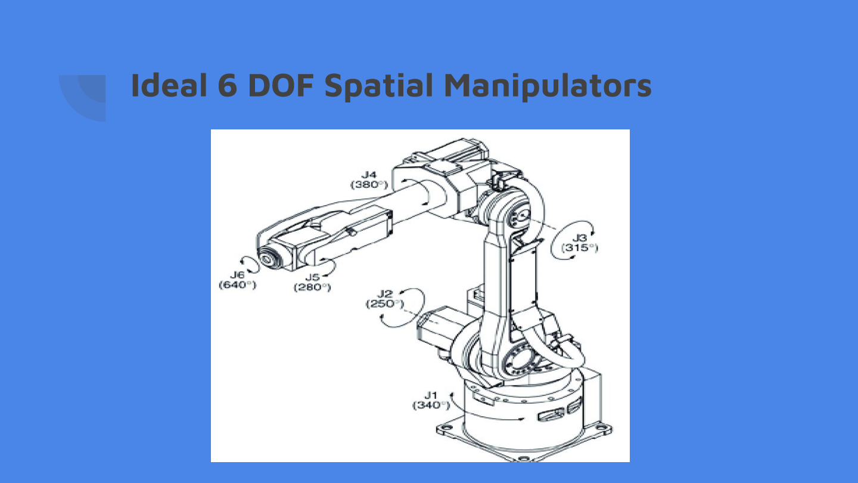
Test 3: 6 DOF Articulated Manipulator

Slide 19
Thank You!

